Slide 1

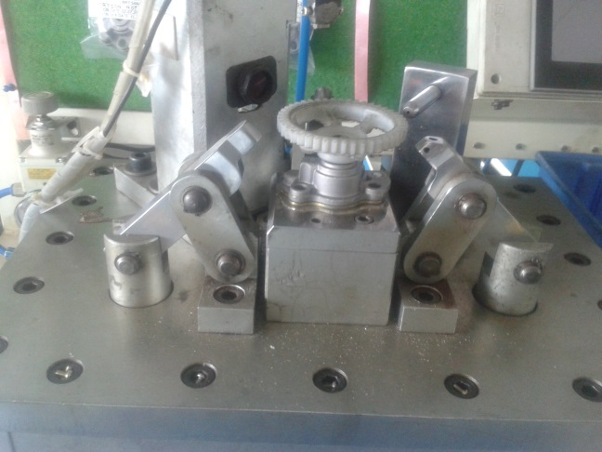
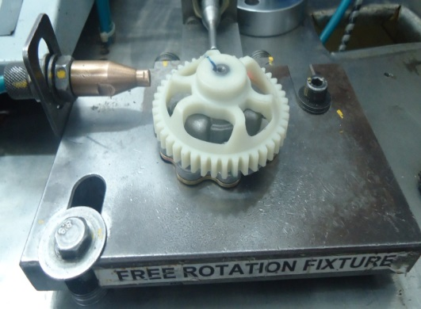
P15
TPM CIRCLE NO :- 3
ACTIVITY
KK
QM
PM
JH
SHE
OT
DM
E&T
KAIZEN IDEA SHEET
TPM CIRCLE NAME : P15 TEAM
LOSS NO. / STEP
DEPT :- Assembly
RESULT AREA
P
Q
DEF :- A
C
D
S
M
CELL :-A106
CELL NAME:- A106 oil pump
MACHINE / STAGE :- A106 Assembly Line
OPERATION :- Free rotation stage.
KAIZEN THEME : To reduce cycle time
IDEA :- To make free rotation in auto mode
COUNTERMEASURE:- Auto clamping at free rotation implemented (Cycle time-22 sec )
BENCHMARK
33 sec.
WIDELY/DEEPLY:-
TARGET
22 No.
KAIZEN START
10.12.2015
PROBLEM / PRESENT STATUS :- Cycle time more due to manual free rotation by tightening three bolts.(Cycle time-33 sec)
KAIZEN FINISH
12.04.2016
TEAM MEMBERS :-
Bhavesh Pednekar, Samadhan Visave
BENEFITS :-
Improve productivity
2. Manpower save
KAIZEN SUSTENANCE
BEFORE
AFTER
WHAT TO DO: To check daily
HOW TO DO: In auto mode
FREQUENCY : 100 %
WHY - WHY ANALYSIS :-
Why1: Cycle time more at free rotation
Why 2: Manual screw tightening
Why 3: Process design
Why 4: No provision in auto mode
Cycle time reduction
RESULT :-
Out put/hrs increased
COST INCURRED FOR MAKING KAIZEN
MATERIAL COST
IN RS
LABOUR COST
IN RS
TOTAL COST
IN RS
ROOT CAUSE :- No provision in auto mode.
------------
-------
---------
SCOPE & PLAN FOR HORIZONTAL DEPLOYMENT
REGISTRATION NO. & DATE: 12.04.16
SR.
NO.
CELL
TARGET
RESPONSIBILITY
STATUS
REGISTERED BY :- Bhavesh Pednekar
---
----
-------
------
------
MANAGER’S SIGN :- Janardan Sathe

